Slide 1
Analysis of Diamond Data Set
Geetha Sowmya Chethi
Ayushi Daksh
Ram Kashyap Cherukumilli Shivani Beth

Slide 2
Objective
Dataset
Variable | Variable Description | Variable Type | Range of values
price | In US dollars | Numeric | 326-18,823
carat | Weight of diamond | Numeric | 0.2-5.01
cut | Quality of cut | Categorical | Fair,Good,Very Good,Premium,Idea
color | Color of Diamond | Categorical | J,I,H,G,F,E,D
clarity | How Clear the diamond is | Categorical | I1, SI2, SI1, VS2, VS1, VVS2, VVS1, IF
x | Length in mm | Numeric | 0-10.74
y | Width in mm | Numeric | 0-58.9
Z | Depth in mm | Numeric | 0–31.8
depth | Total Depth percentage = z / mean(x, y) = 2 * z / (x + y) | Numeric | 43-79
table | width of top of diamond relative to widest point (43–95) | Numeric | 43–95
Predict the Price of Diamond based on the predictors of the diamond.
Decide most important features that determine the Price of the Diamond.
This Dataset has 6 numeric variables carat, x, y, z depth, table.
Three categorical variables cut, color, clarity.
54000 records in the dataset.

Slide 3
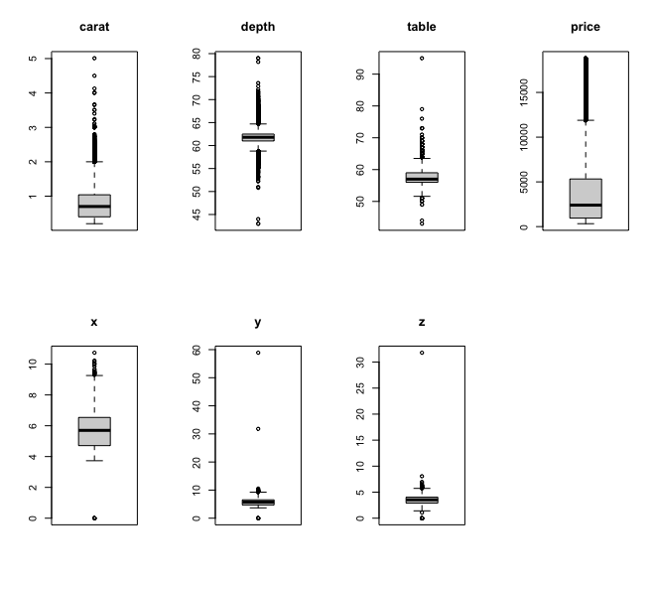
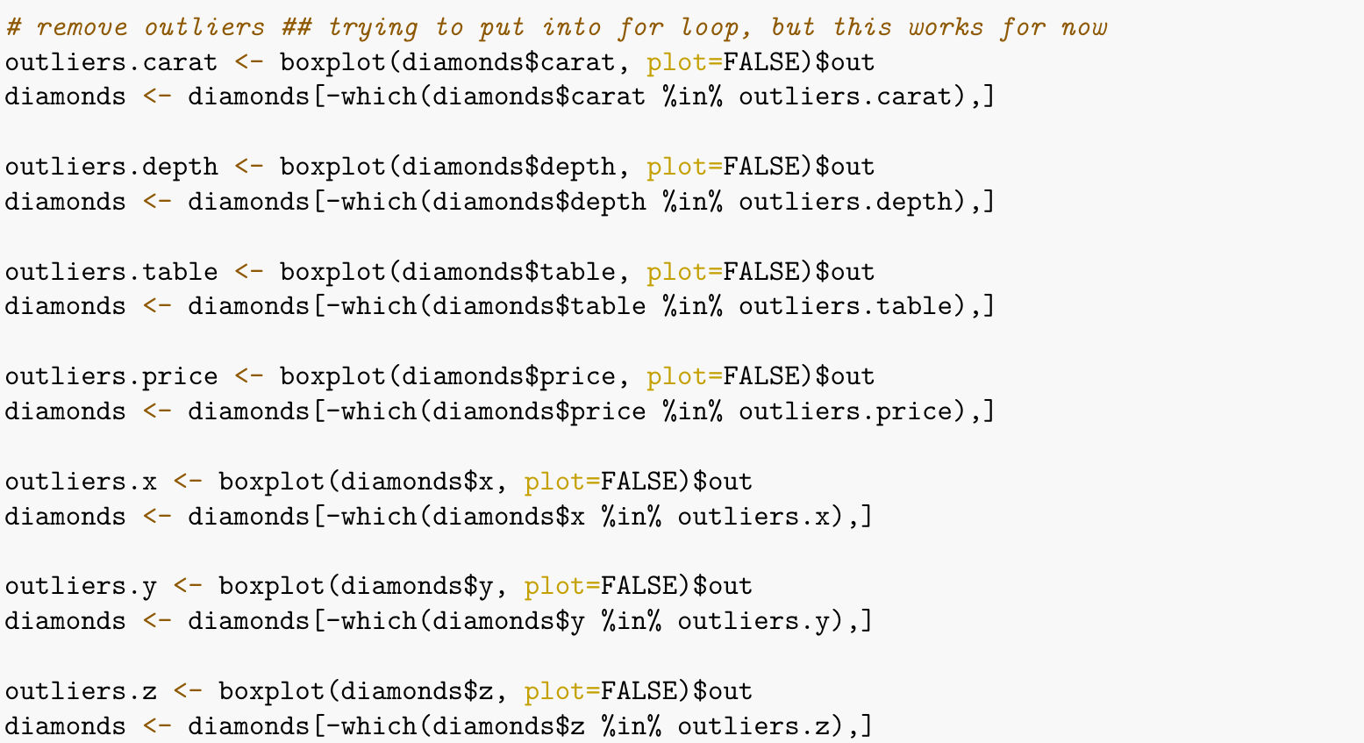
Outlier Detection
Boxplots
Plots of all the numerics features in order to check for the outliers.
Removal of outliers from the numerical columns.
After removing outlier we have 47000 records in our dataset

Slide 4
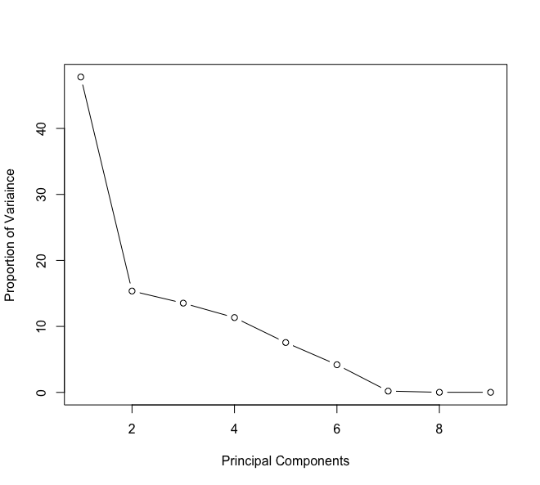
Principle Component Analysis(PCA)
Scree plot
To decide on the most important features Principal component Analysis is uses as it reduces dimensions
From scree plot 6 principal components are required to explain maximum variance of dataset
Built statistical models on first 6 principal components

Slide 5
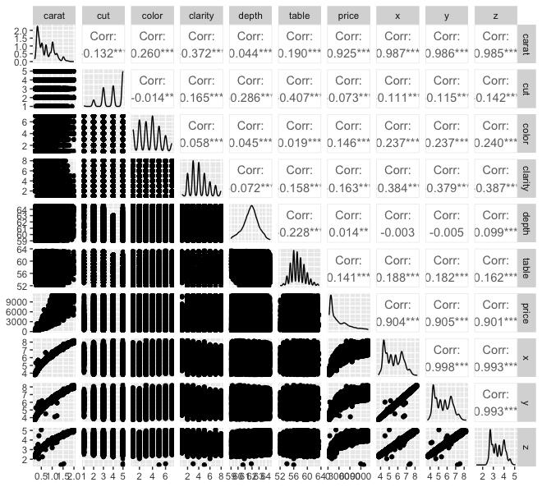
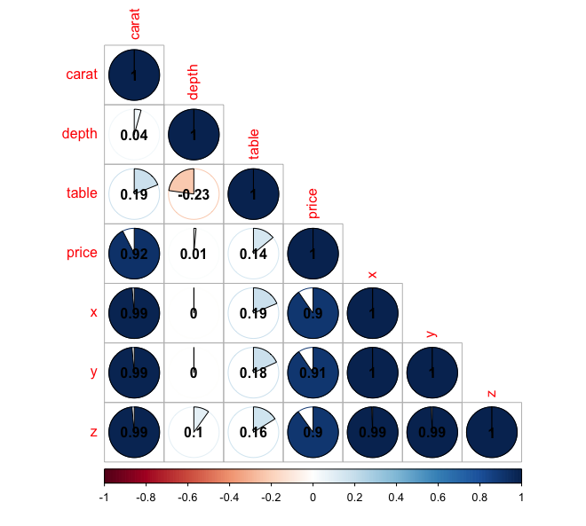
Pairwise Association
From both the plots it is evident that Price is highly correlated to carat, x,y ,z
Carat is highly correlated to x, y, z predictors. So removing x,y,z from the dataset

Slide 6
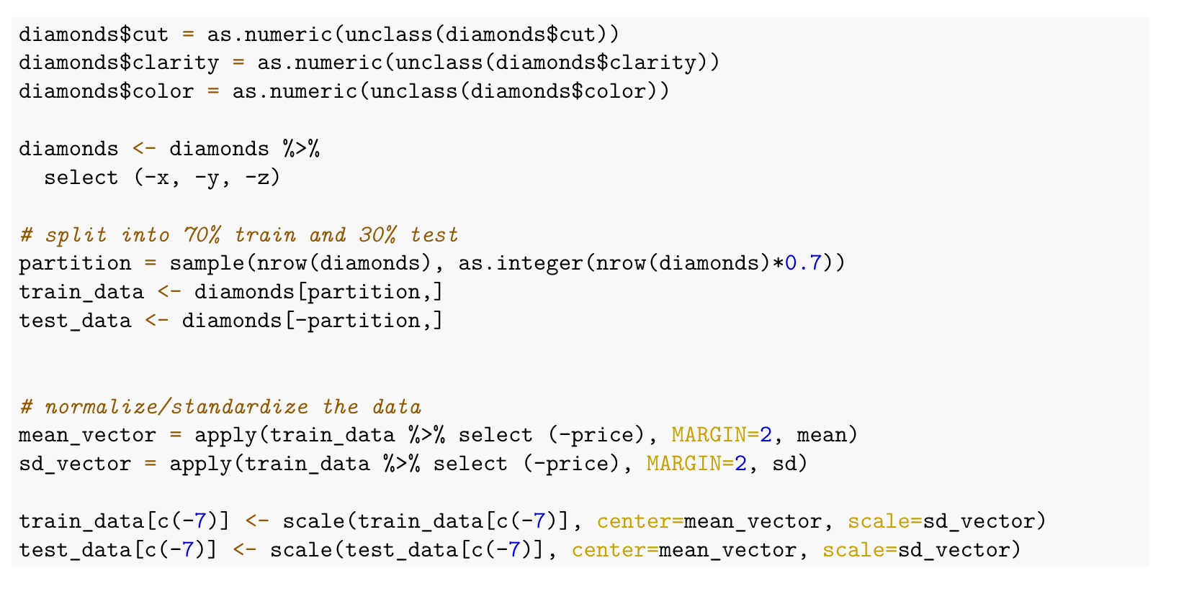
Data Splitting and Encoding
Removed predictors based on EDA
Encoded values for categorical variables
Split the dataset into Train - 70% Test - 30%
Normalization of data

